Slide 1
DESIGN AND IMPLEMENTATION OF SECURITY INFORMATION AND EVENT MANAGEMENT(SIEM) SYSTEM FOR MONITORING SECURITY EVENTS IN A BUSINESS ORGANIZATION
PRESENTED BY
B CHAITANYA (22BFA37015)
A ALWIN RAJ (22BFA37008)
C. VINITHA VARMA (22BFA37026)
D V SAI PRAHARSHA (22BFA37034)
Under The Guidance of
K NAGENDRA RAO
Associate Professor, Dept of CSC
Department of Computer Science And Engineering
S V COLLEGE OF ENGINEERING
(Autonomous)
Karakambadi Road, Opp. LIC Training Center
Tirupati-517507

Slide 2
CONTENTS
Abstract
Introduction
Literature Review
Existing System
Proposed System
Modules Description
UML Diagrams
Software and Hardware requirements
Project Implementation
Testing
Results
Future Enhancements
Conclusions
References

Slide 3
ABSTRACT
In today’s digital era, business organizations face increasing cybersecurity threats such as malware attacks, phishing, insider threats, and unauthorized access. Managing and monitoring security events manually is inefficient and prone to errors due to the large volume of logs generated across an organization’s IT infrastructure. To address this challenge, the proposed system implements a Security Information and Event Management (SIEM) solution that collects, analyzes, and monitors security logs in real time.
The system aggregates logs from various sources including servers, firewalls, routers, endpoints, and applications, and correlates these events using predefined security rules to identify suspicious activities. When potential threats are detected, the system generates real-time alerts that help administrators respond quickly to security incidents. This project demonstrates how implementing a SIEM system enhances an organization’s cybersecurity posture by enabling proactive monitoring, efficient log management, and intelligent threat detection.

Slide 4
INTRODUCTON
Cybersecurity threats have increased significantly due to the growing dependence on digital infrastructure. Organizations face multiple threats including malware attacks, phishing, insider threats, data breaches, and unauthorized access.
Security Information and Event Management (SIEM) systems provide a centralized platform that collects logs from multiple sources and analyzes them to identify security incidents.
The main objective of this project is to design and implement a SIEM system that helps organizations monitor security events effectively and detect potential threats in real time.
Functions are
a) Log Collection b) Event Correlation and analysis
c) Threat Detection d) Real-time monitoring
e) Security alert generation f) Compliance reporting

Slide 5
LITERATURE REVIEW
Tite | Author(s) | Year | Algorithms Used
Security Information and Event Management (SIEM): A Review | Behl & Behl | 2021 | Overview of SIEM architecture and log correlation techniques
Log Management and Security Monitoring using SIEM | Kent & Souppaya | 2020 | Discusses importance of centralized log monitoring
Security Event Correlation Techniques | Julisch | 2019 | Event correlation for intrusion detection
Practical SIEM Implementation | Shackleford | 2022 | Methods for deploying SIEM in enterprise environments

Slide 6
EXISTING SYSTEM
Many organizations currently rely on traditional security monitoring systems such as firewalls, antivirus software, and manual log analysis.
Limitations of existing systems include:
Logs are stored separately across different systems
Manual Monitoring
Difficult to detect advanced cyber attacks
Lack of Centralized monitoring
Delayed incident Detection

Slide 7
PROPOSED SYSTEM
The proposed system implements a Security Information and Event
Management (SIEM) solution to monitor and analyze security
organization’s IT infrastructure.
Key features include:
a) Centralized log collection from multiple devices
b) Real-time event monitoring
c) Event correlation to detect suspicious activities
d) Security alert generation
e) Dashboard for monitoring security events
f)Log storage and analysis

Slide 8
MODULE DESCRIPTION
Project Modules
Log Collection Module
Log Processing Module
Event correlation module
Alert Generation Module
Monitoring Dashboard
Reporting Module

Slide 9
MODULE DESCRIPTION
Data Collection and Processing
The collected logs may include information such as:
User Login activities
Network Traffic events
System Errors and warnings
Firewall alerts
Application Access logs
Log processing steps include:
Filtering irrelevant logs
Parsing log messages
Normalizing log formats
Strong logs in a centralized log database

Slide 10
MODULE DESCRIPTION
Event Correlation and Analysis
The system analyzes logs using predefined security rules such as:
Multiple failed login attempts
Access from unknown IP addresses
Unauthorized privilege escalation
Malware activity activity detection
Abnormal network traffic patterns

Slide 11
MODULE DESCRIPTION
Security Model Evaluation
The system classifies events into categories such as:
a) Information Events b) Warning Events c) Critical Incidents
Evaluation Criteria Include:
a) Frequency of Suspicious events b) Type of activity detected
c) Source of the event d) Risk level of affected system
This evaluation helps administrators prioritize responses and quickly handle high-risk threats.

Slide 12
MODULE DESCRIPTION
Security Monitoring and Alert System
The SIEM system continuously monitors incoming logs and identifies potential security threats in real time.
a) Generates alerts b) Sends notification to administrators
c) Displays warnings on the monitoring dashboard
Examples of alerts include:
a) Unauthorized login attempts b) Malware detection
c) Firewall policy violations d) Suspicious network activity

Slide 13
MODULE DESCRIPTION
Database Integration
The SIEM system integrates a centralized database to store all collected security logs and detected events.
Database stores information such as:
a) Log records b) Security Alerts c) Incident reports
d) User Activity logs
This Centralized storage allows administrators to:
a) Search historical logs b) Perform forensic analysis
c) Generate security reports d) Track previous incidents
Databases commonly used in SIEM systems include
a) Elasticsearch b) MySQL c) MongoDB

Slide 14
MODULE DESCRIPTION
User Interface
The user interface provides a dashboard that allows administrators to monitor security events in real time.
The User displays:
a) Security alerts
b) System status
c) Log Statistics
d) Threat detection reports
e) Event Timelines

Slide 15
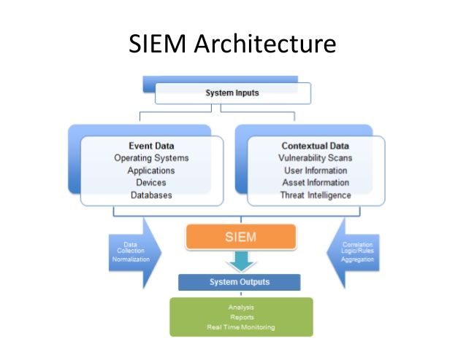
ARCHITECTURE

Slide 16
UML DIAGRAMS
UML represents Unified Modelling Language.
UML diagram is a way to visualize systems and software using Unified Modelling Language (UML).
It is a standardized modelling language used in software engineering to visualize, specify, construct, and document the artifacts of software systems.
Some of those are:-
Use Case Diagram
Sequence Diagram
Component Diagram
Class Diagram
Activity Diagram
Deployment Diagram

Slide 17
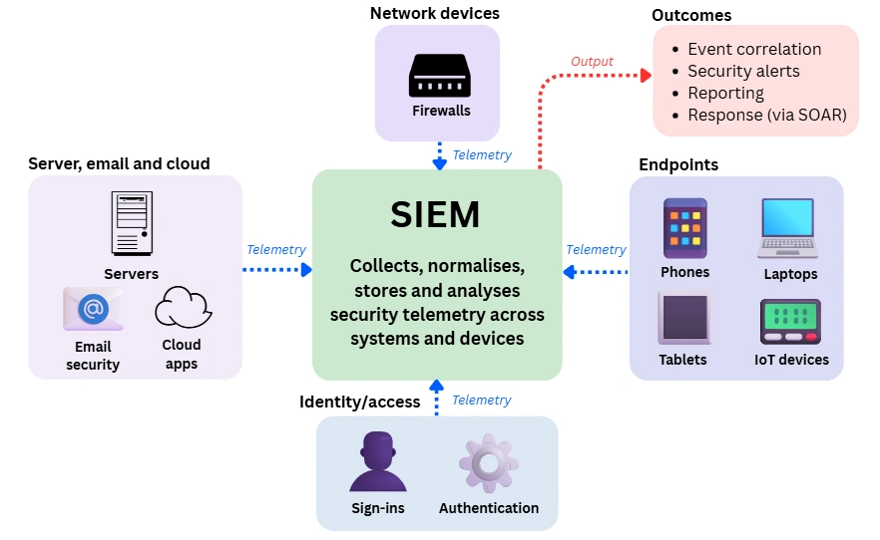
ACTIVITY DIAGRAM
Activity diagrams are graphical representations of workflows of stepwise activities and actions with support for choice, iteration and concurrency.
An activity diagram shows the overall flow of control.

Slide 18
SYSTEM REQUIREMENTS
Software Requirements:-
Application platform : Python 3.0 & above
Operating System : Linux / Windows
Database : Elastic Search
IDE : Visual Studio Code
Hardware Requirements:-
RAM : 8 GB & Above
Processor : Intel I3 & Above
CPU : 1.6GHz & Above
Hard Disk : 256 GB

Slide 19
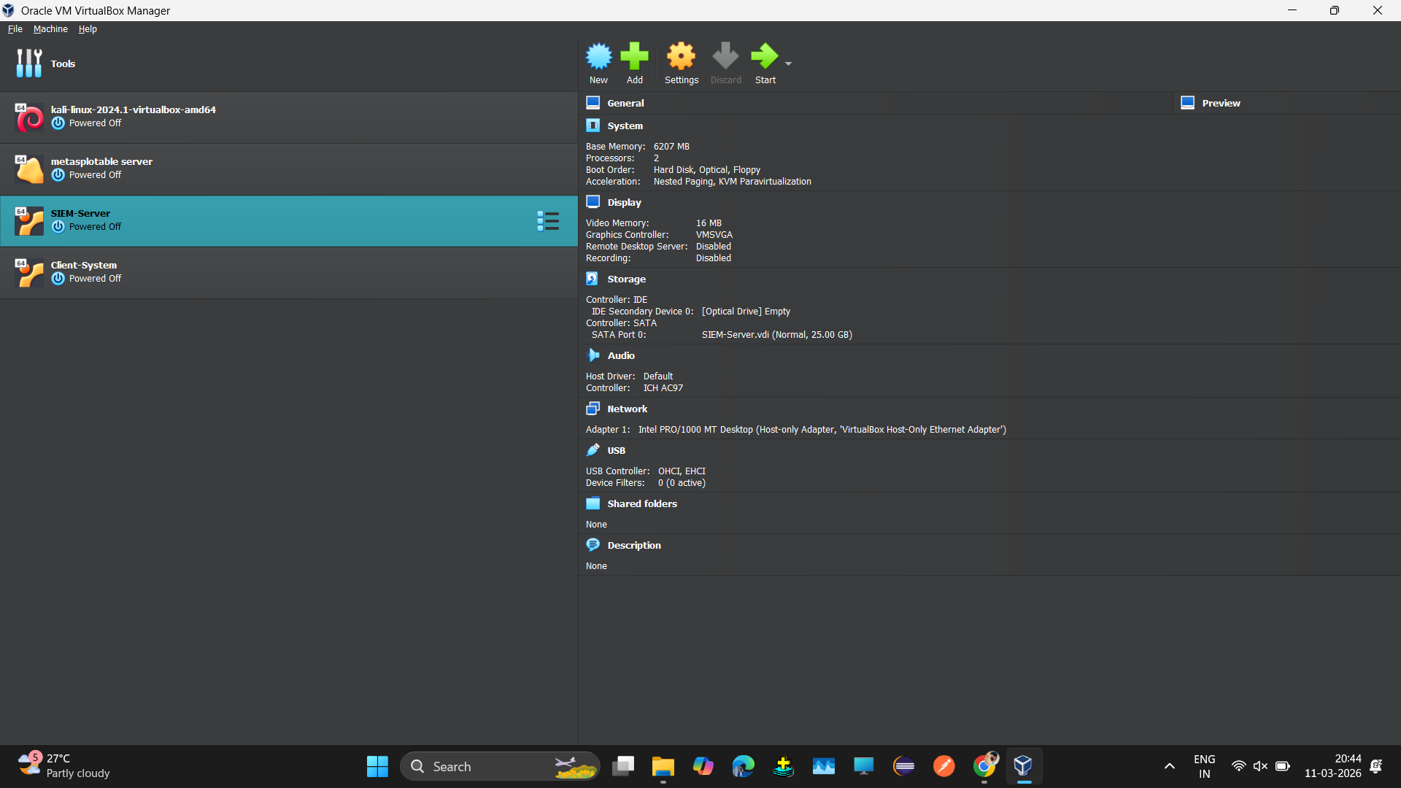
PROJECT IMPLEMENTATION

Slide 20
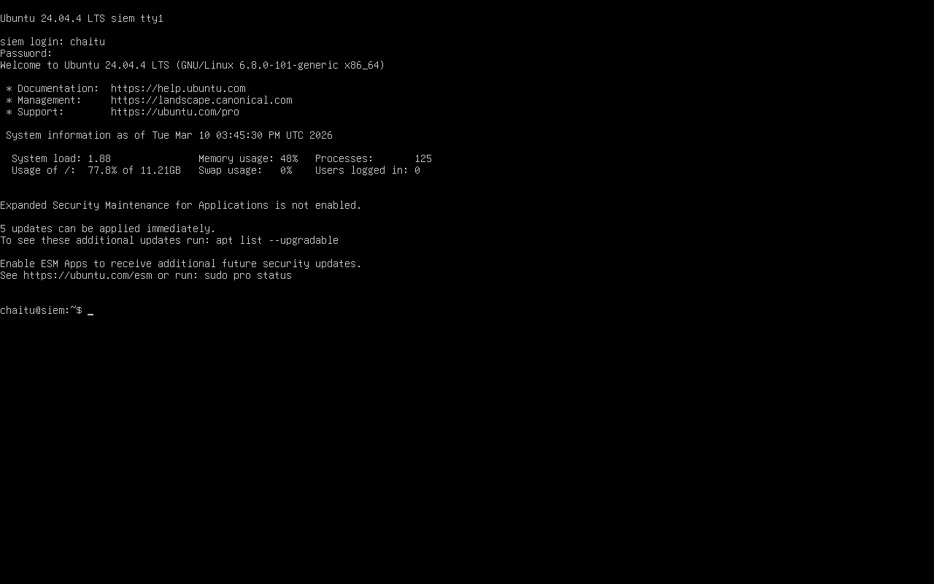
PROJECT IMPLEMENTATION

Slide 21
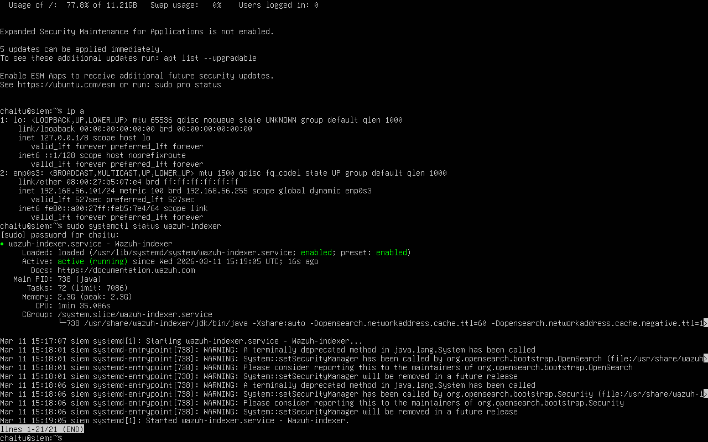
PROJECT IMPLEMENTATION

Slide 22
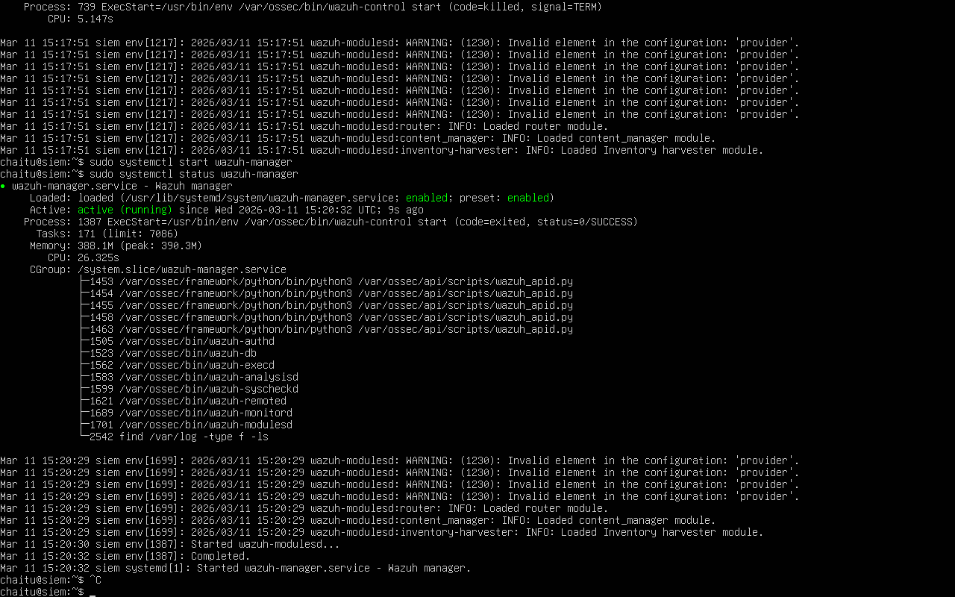
PROJECT IMPLEMENTATION

Slide 23
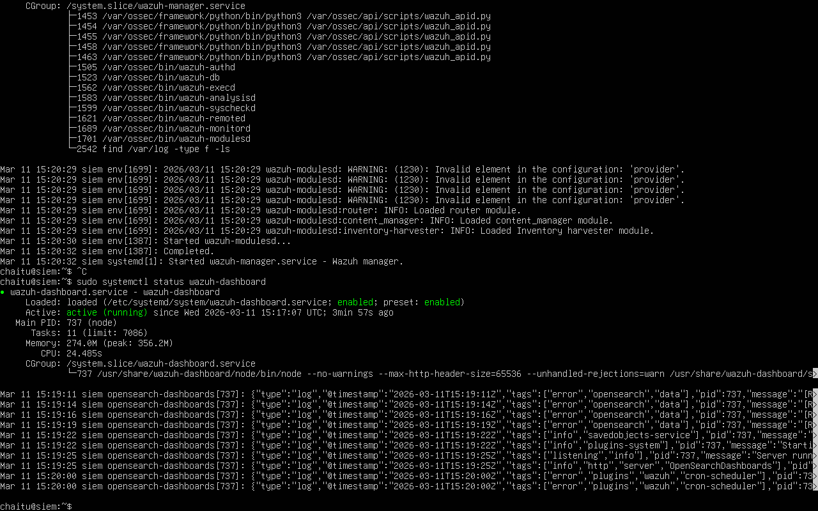
PROJECT IMPLEMENTATION

Slide 24
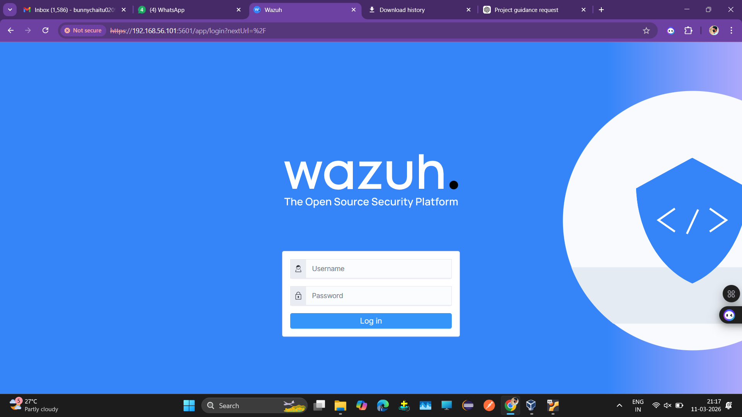
PROJECT IMPLEMENTATION

Slide 25
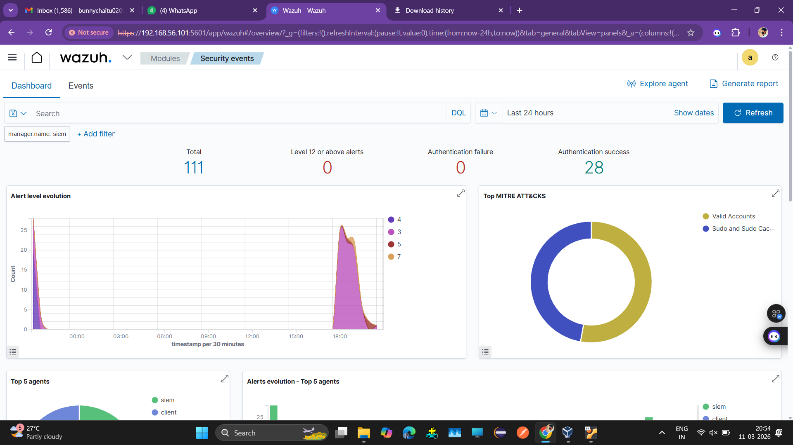
PROJECT IMPLEMENTATION

Slide 26
TESTING
Unit Testing
Unit testing is testing the smallest testable unit of an application. It is
done during the coding phase by the developers.
Unit Testing helps in finding bugs early in the development process.
Testing the prediction system code.
Test Cases:
Function | Test Description | Input | Expected Output | Pass Criteria
Log Collection | Collect logs from server | Server log data | Logs successfully stored | Logs successfully received and stored in databas
Log Processing | Test log parsing and normalization | Raw log files | Logs converted into structured format | Logs correctly formatted and stored
Event Detection | Detect suspicious login attempts | Multiple failed login attempts | Security event detected | System correctly identifies suspicious activity
Alert Generation | Trigger alert when a security rule is activated | Security event detected | Alert notification generated | Alert displayed in dashboard and notification sent
Database Storage | Store processed logs in database | Processed log data | Logs stored in centralized database | Logs successfully saved and retrievable

Slide 27
TESTING
Integration Testing
Integration Testing is a type of software testing in which the different units, modules or
components of a software application are tested as a combined entity.
It helps in identifying integration issues between the modules and also ensures that the
integrated modules work properly before moving to the system testing of the complete
application.
Test Case:
Test Scenario | Input | Expected Output | Pass Criteria
Security Event Detection Workflow | Multiple failed login attempts from a user | System detects suspicious activity and generates alert | Alert appears in dashboard and stored in database
Log Monitoring Process | Server and firewall logs | Logs collected and displayed in monitoring dashboard | Logs visible in real-time dashboard

Slide 28
TESTING
System Testing
Tests the entire SIEM system after integration
Verifies log collection from multiple sources
Checks threat detection and alert generation
Ensures dashboard displays real-time security events
Confirms report generation and system functionality

Slide 29
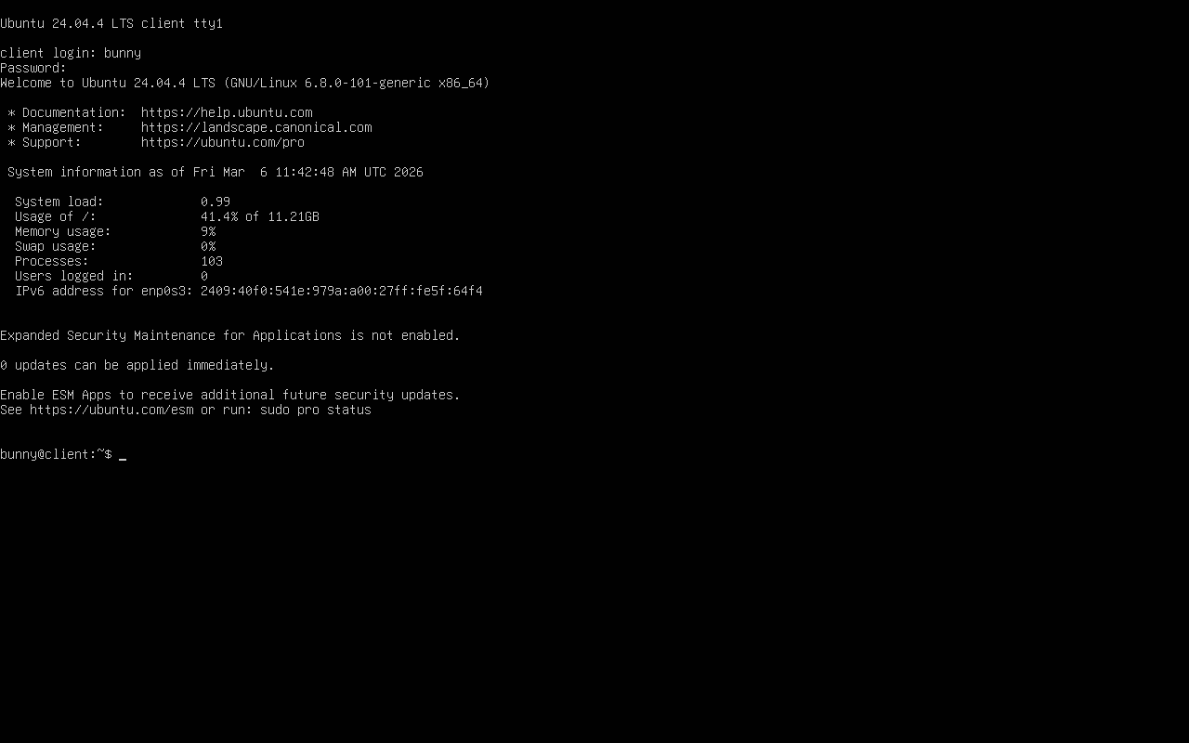
RESULTS

Slide 30
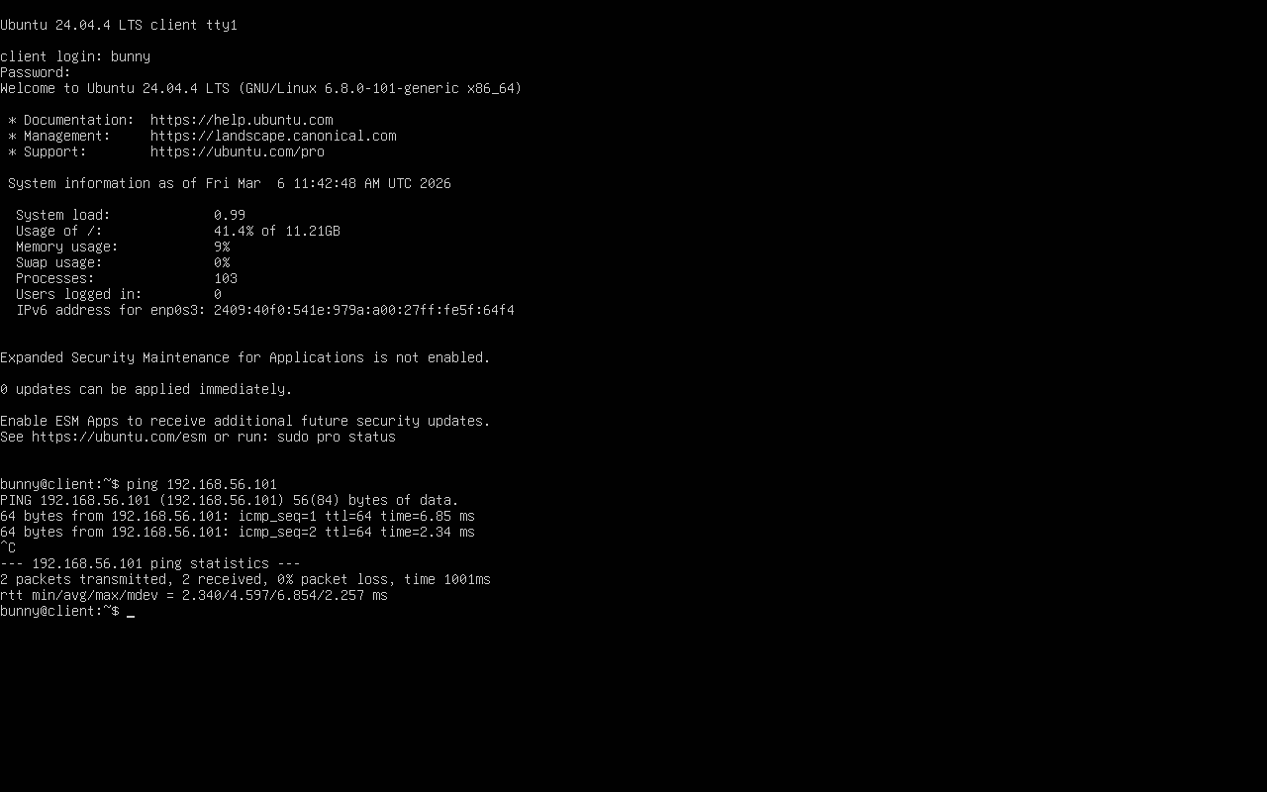
RESULTS

Slide 31
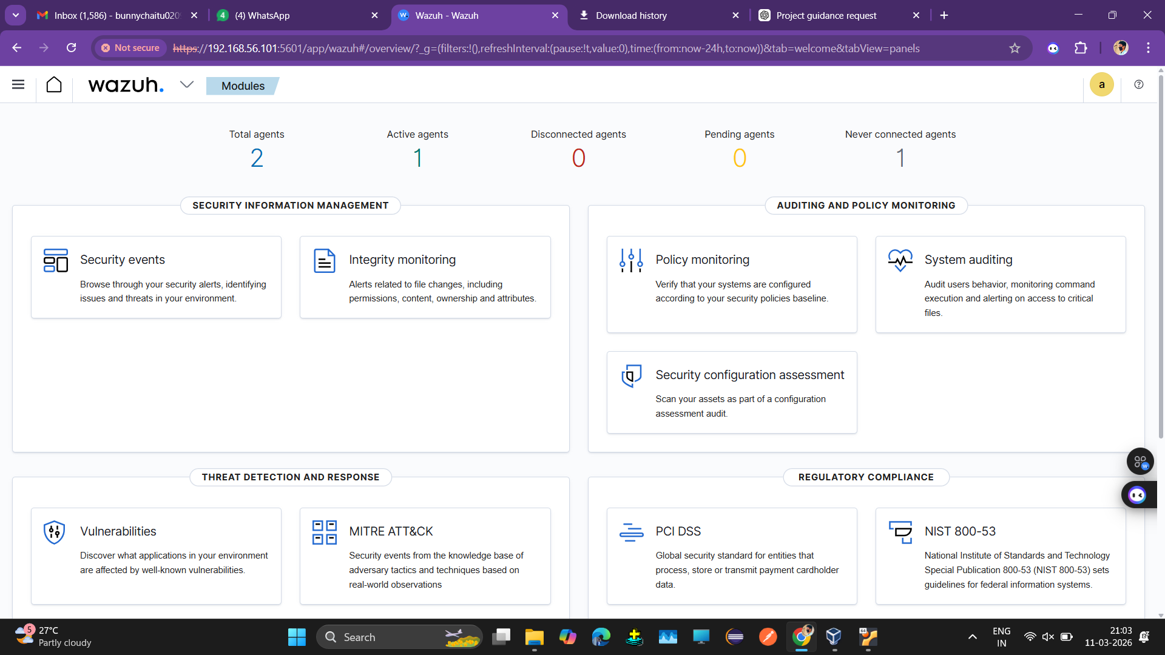
RESULTS

Slide 32
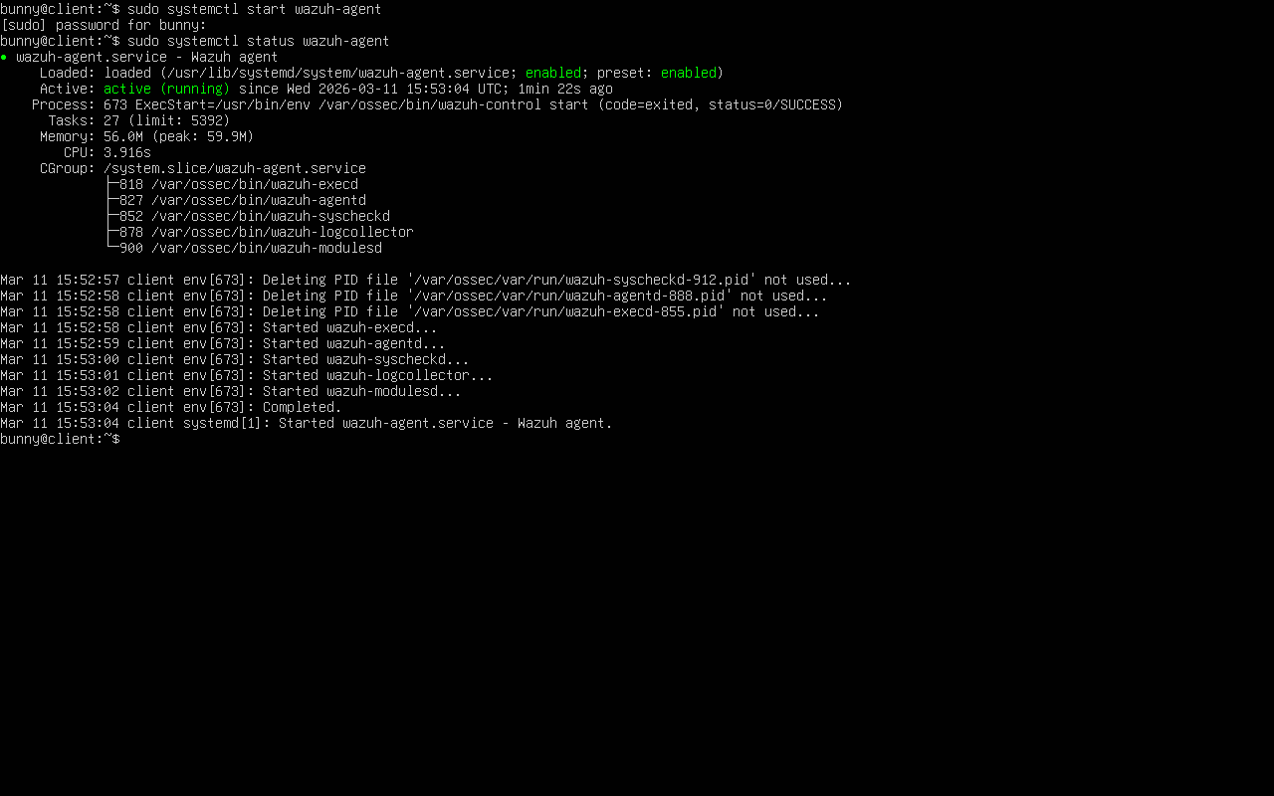
RESULTS

Slide 33
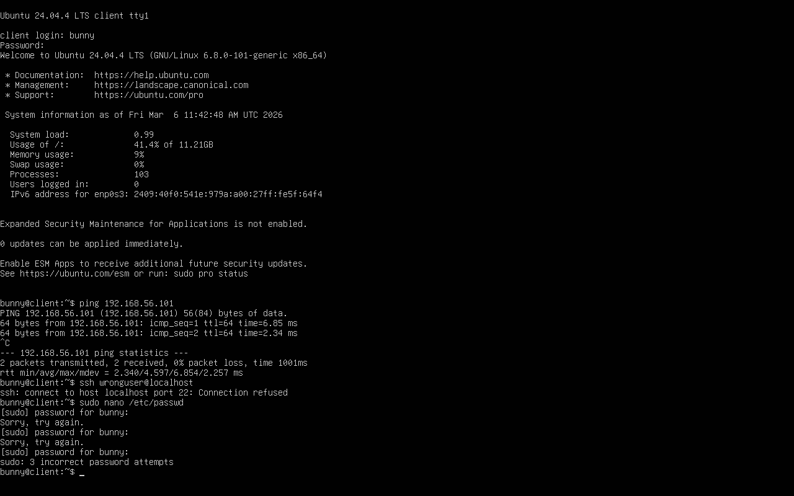
RESULTS

Slide 34
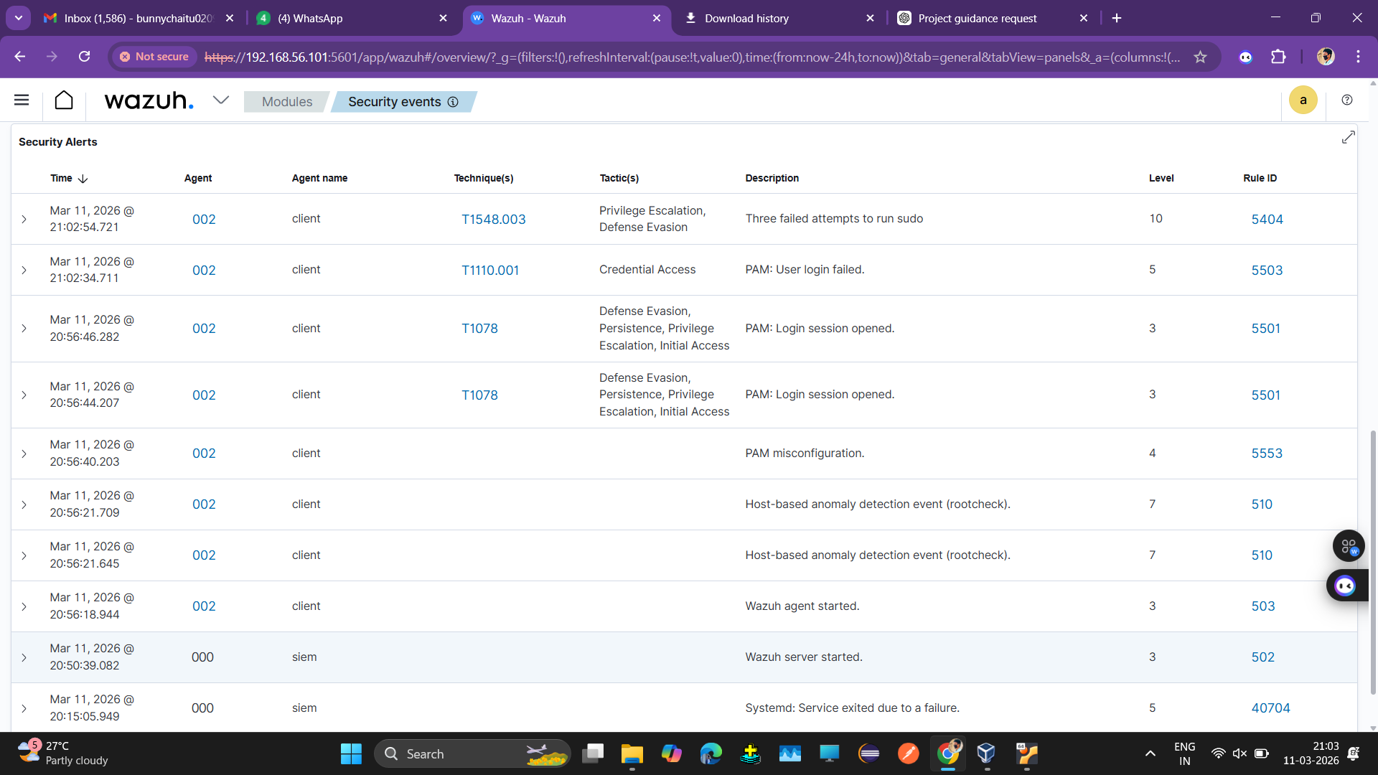
RESULTS

Slide 35
FUTURE ENHANCEMENTS
Automated Incident Response: The system can be enhanced to automatically respond to security incidents by blocking malicious IP addresses, disabling compromised user accounts, or isolating infected systems
Threat Intelligence Integration: External threat intelligence feeds can be integrated into the system to identify known malicious IP addresses, domains, and attack signatures.
Advanced Visualization and Reporting: Future improvements can include advanced dashboards and graphical reports that help administrators better analyze security trends and incidents.
Scalability Improvements: The system can be enhanced to handle large volumes of logs generated by large-scale enterprise networks.

Slide 36
CONCLUSIONS
The project successfully demonstrates the design and implementation of a Security Information and Event Management (SIEM) system for monitoring security events within a business organization. The system collects logs from various sources such as servers, network devices, and endpoints, and analyzes them to detect suspicious activities and potential security threats. By providing centralized log management, real-time monitoring, and alert generation, the SIEM system helps administrators quickly identify and respond to security incidents. Overall, this project highlights the importance of SIEM solutions in strengthening an organization’s cybersecurity infrastructure and improving its ability to detect and manage security threats effectively.

Slide 37
Thank You

